Slide 1
PWA workshop
Part 2
Workbox
Notes:
https://the-guide.github.io/fe-guild-2019-pwa-code-labs/codelabs/workbox#0

Slide 2
Using Workbox

Slide 3
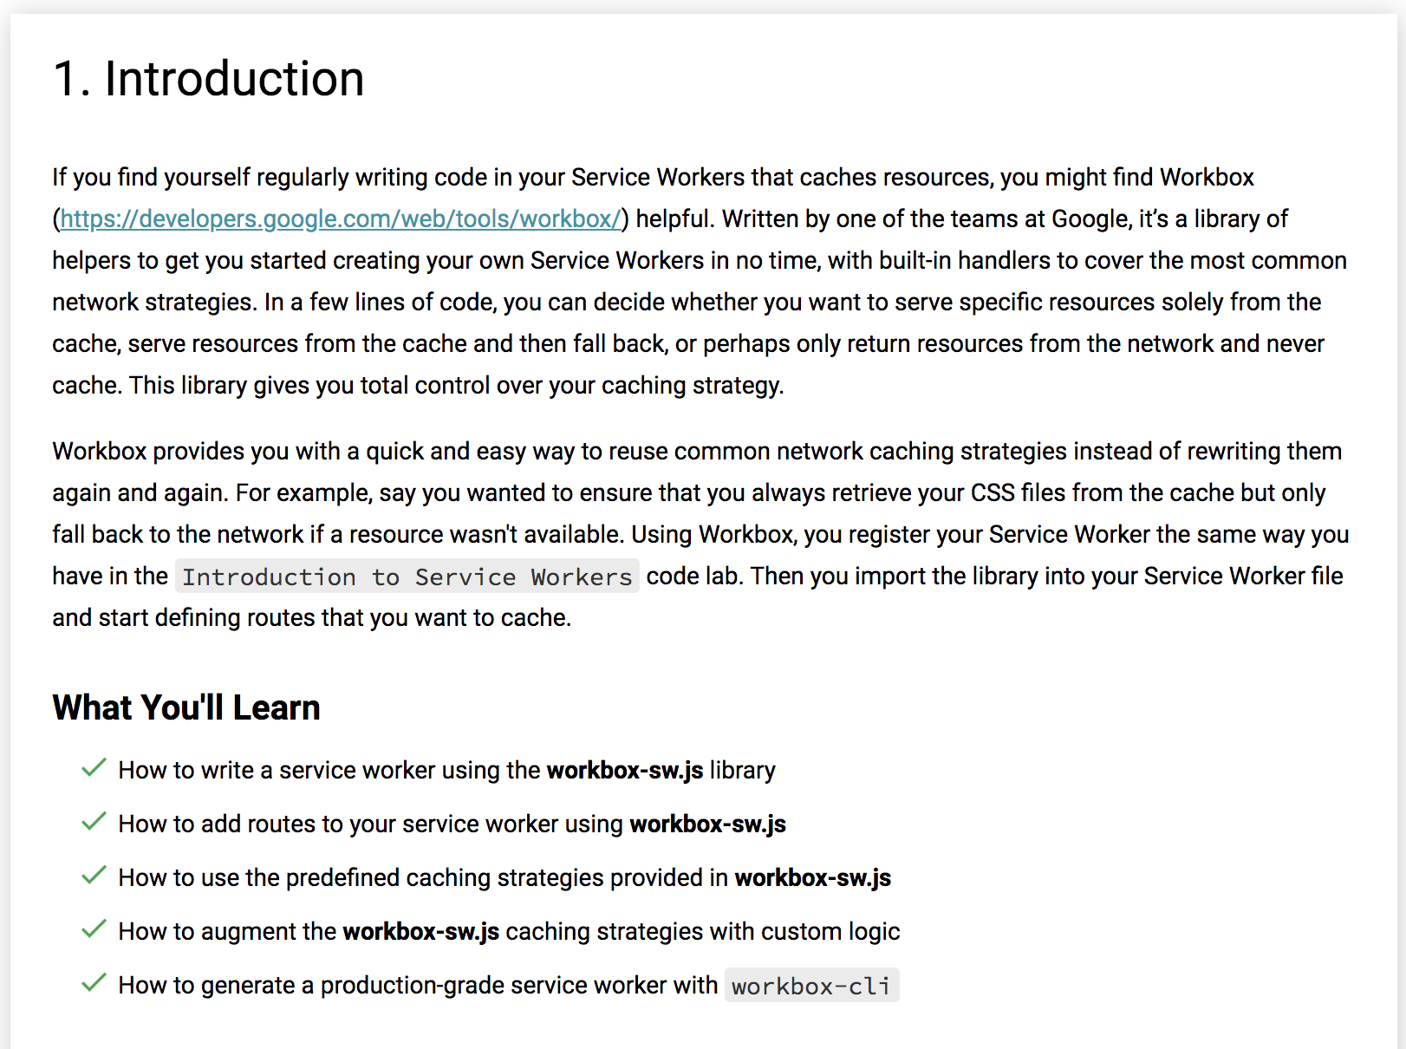

Slide 4
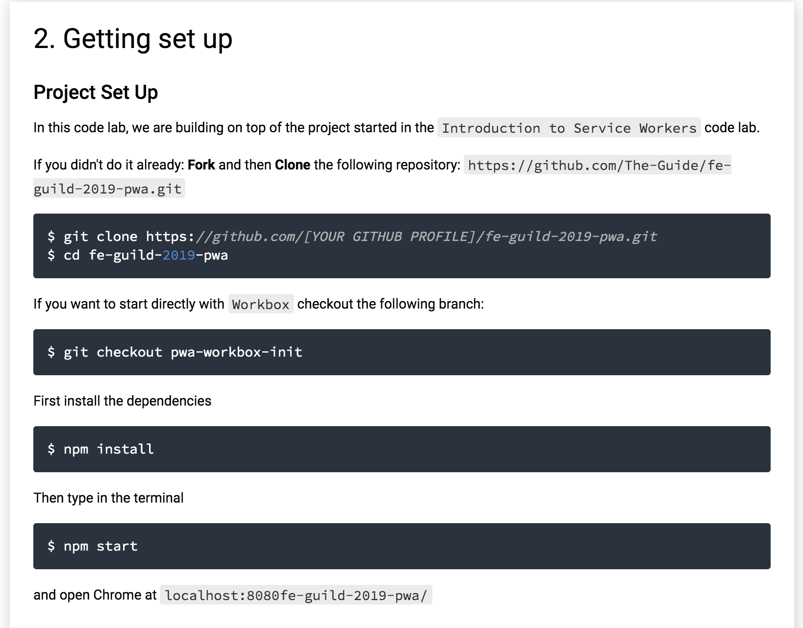

Slide 5
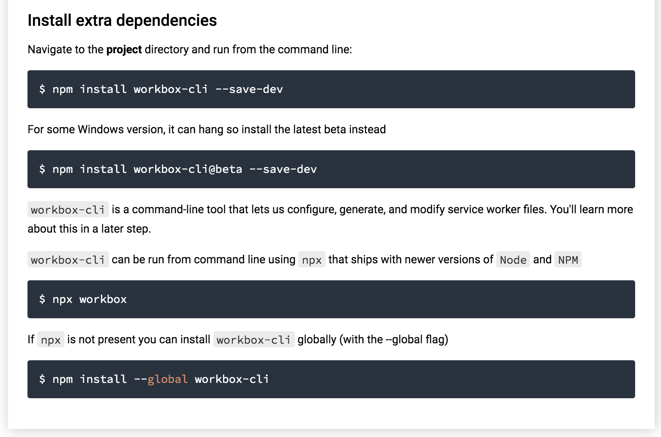

Slide 6
3. Create a basic service worker
Rename the sw.js from the previous code lab and create a new empty one with the same name (sw.js)
ADD in sw.js:
importScripts('https://storage.googleapis.com/workbox-cdn/releases/3.5.0/workbox-sw.js');
if (workbox) {
console.log(`Yay! Workbox is loaded 🎉`);
workbox.precaching.precacheAndRoute([]);
} else {
console.log(`Boo! Workbox didn't load 😬`);
}

Slide 7
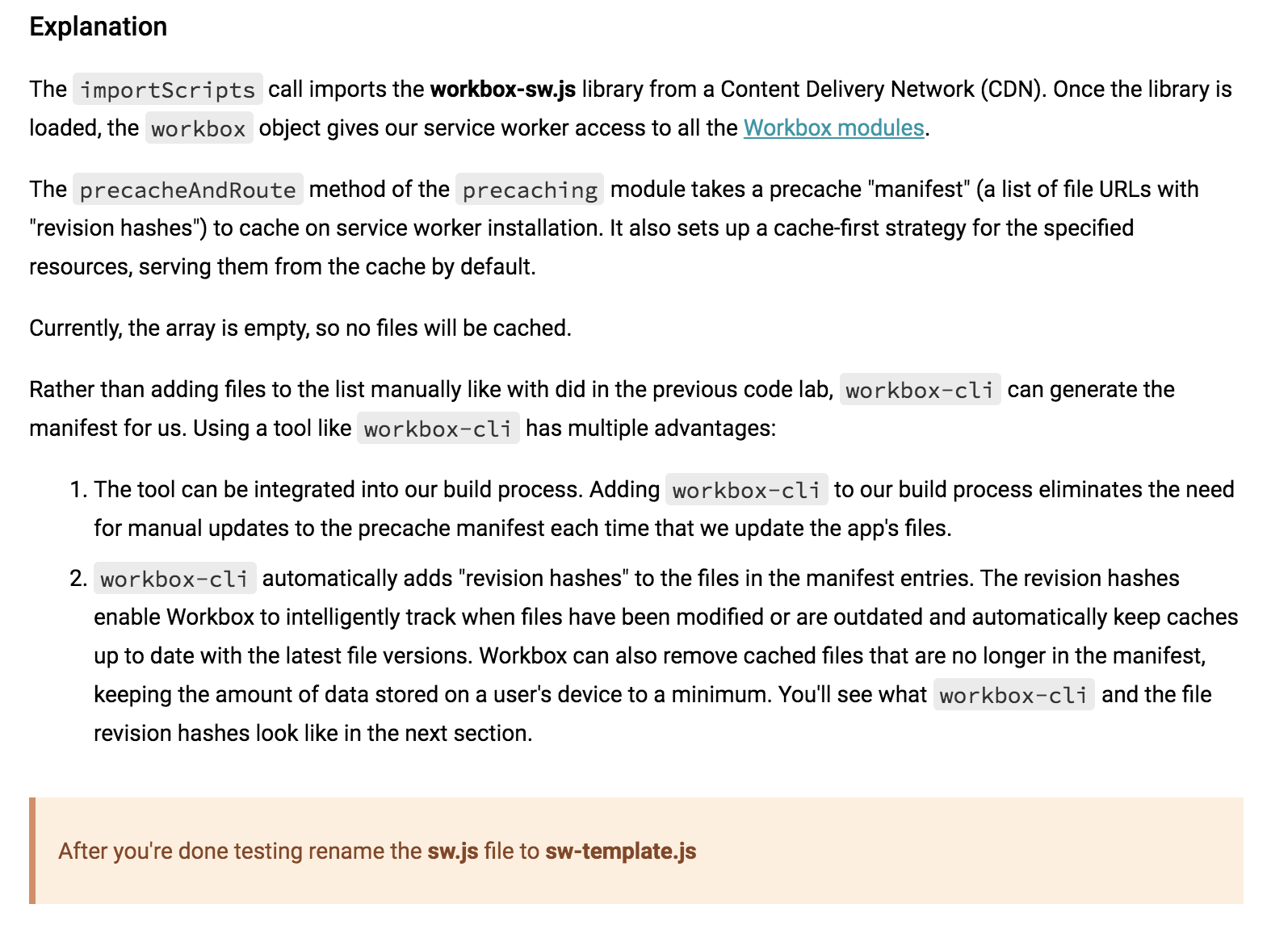

Slide 8
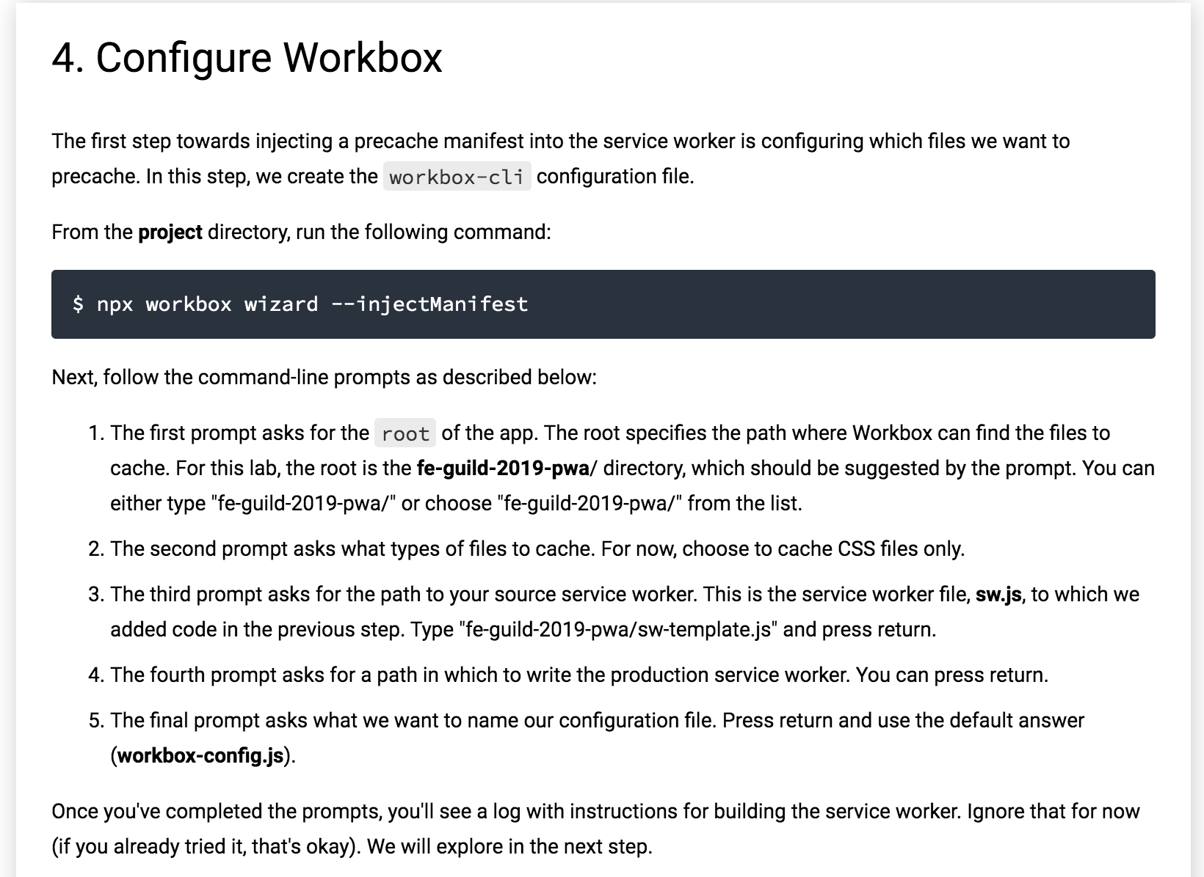

Slide 9
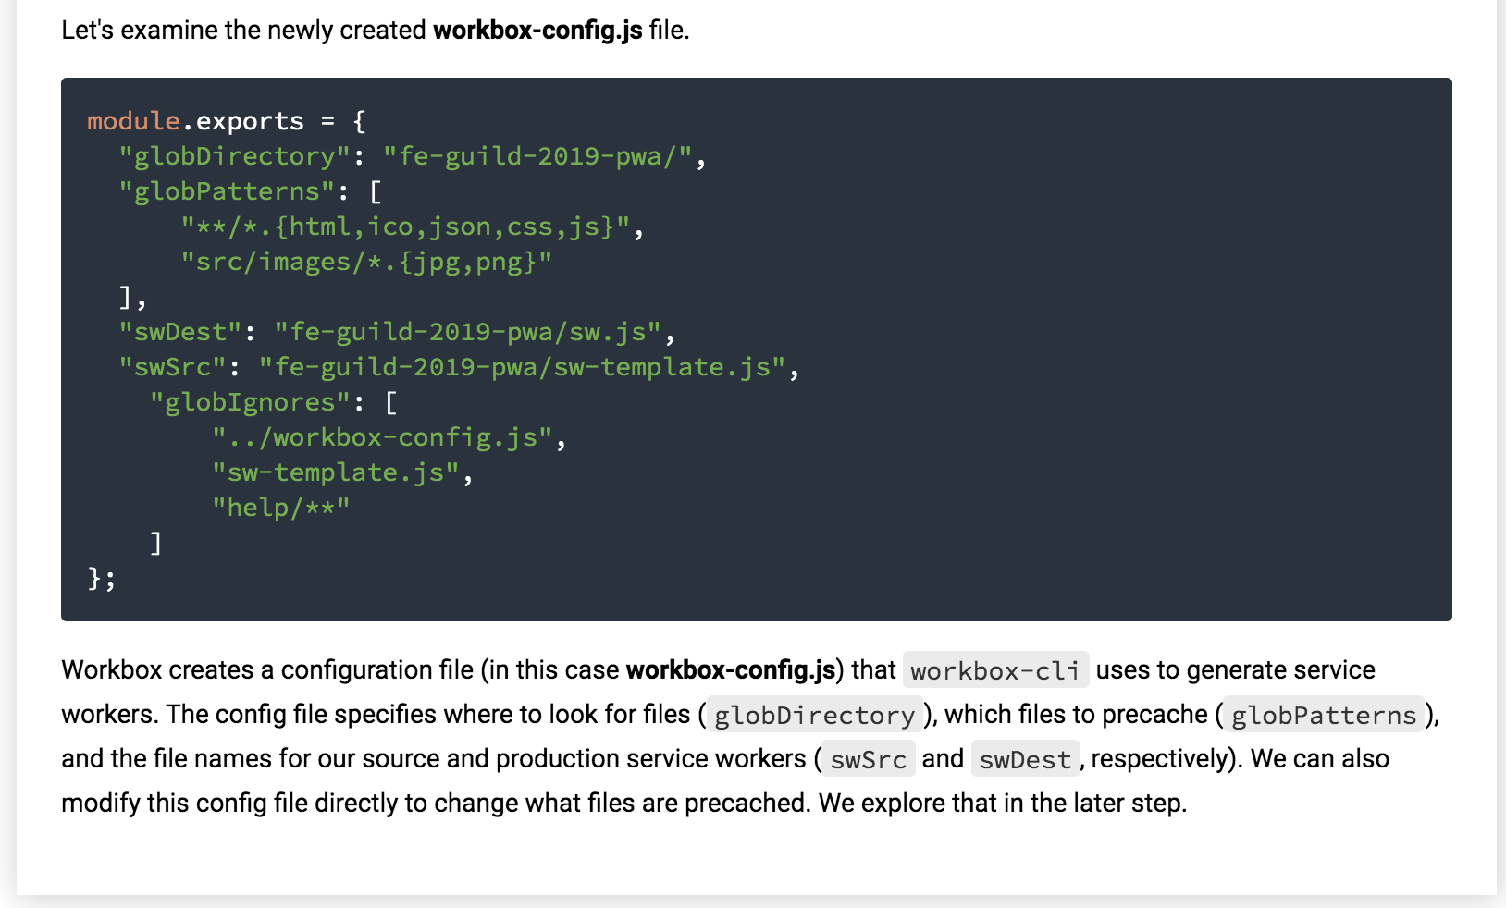

Slide 10
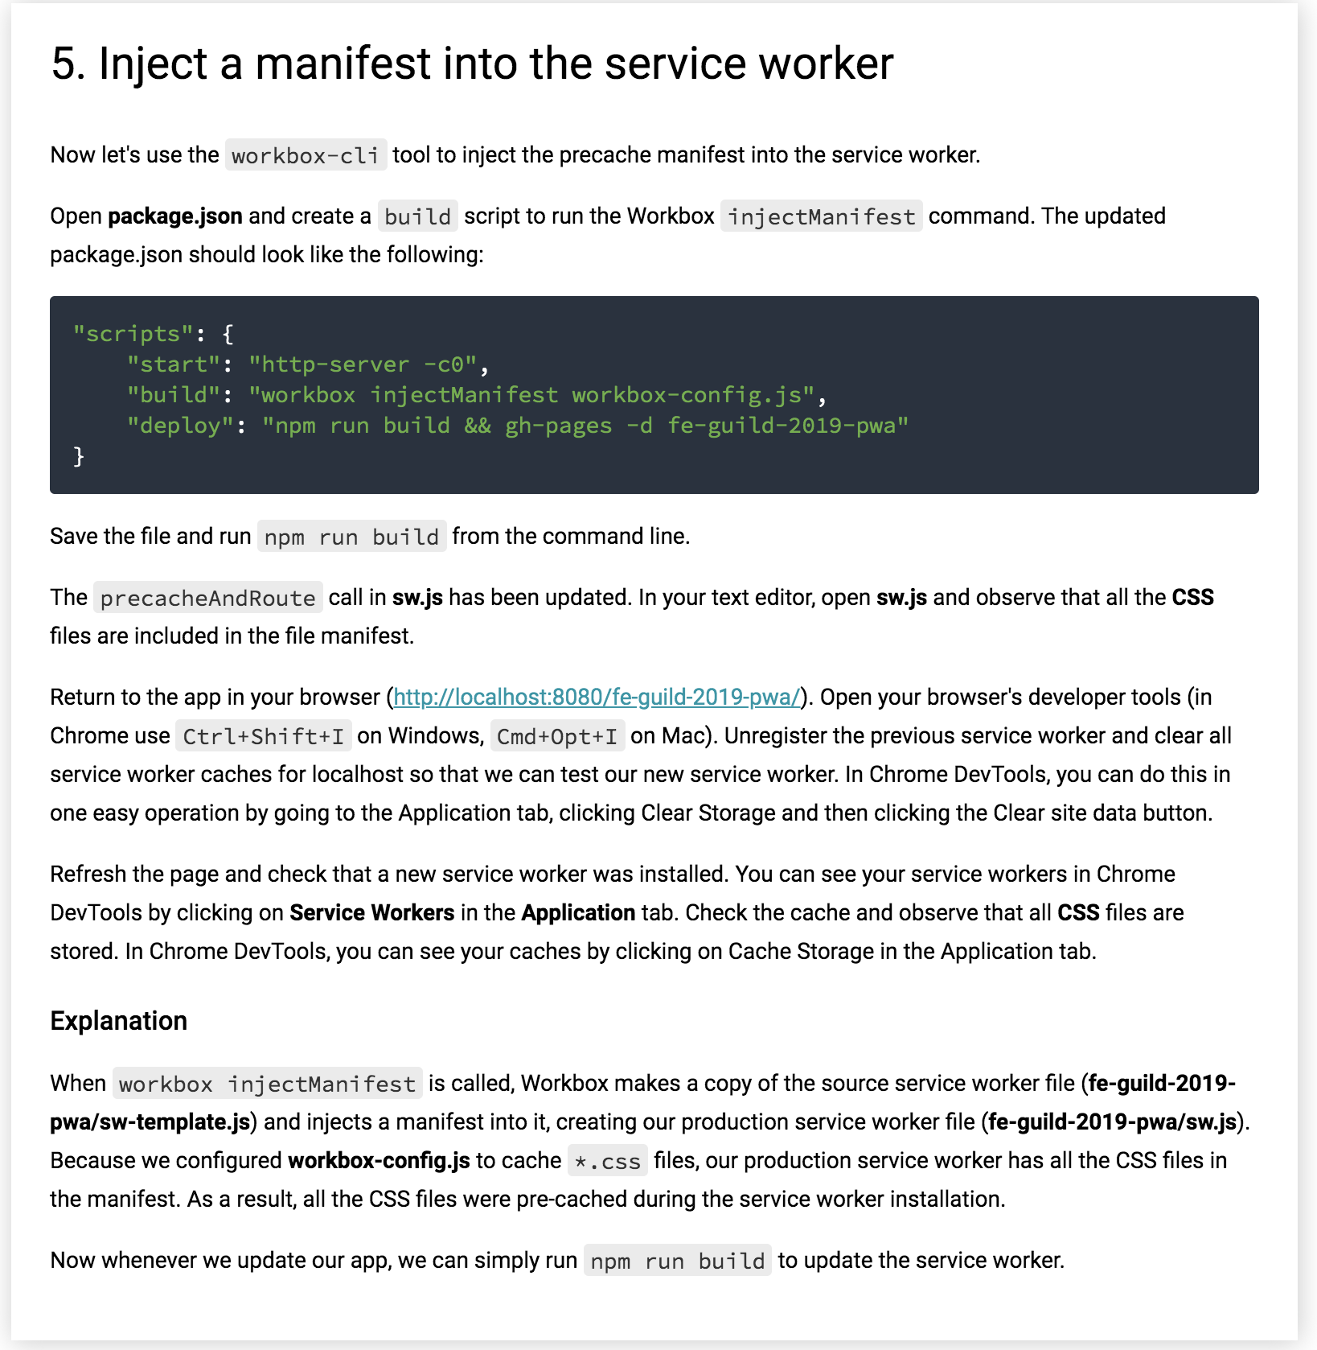

Slide 11
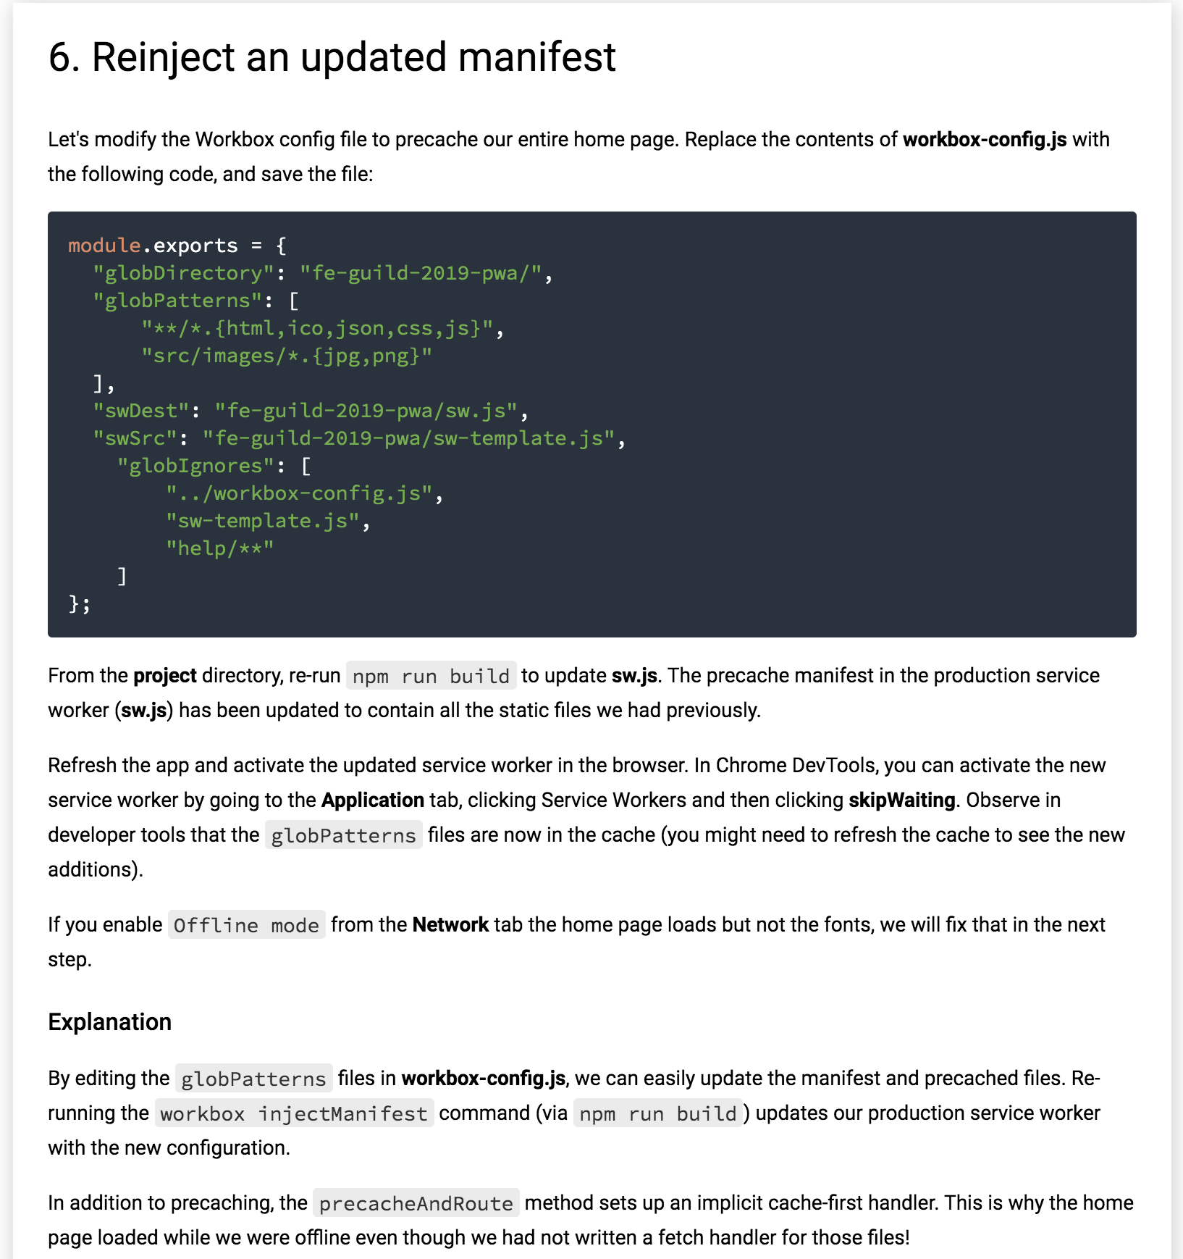

Slide 12
7. Add routes to the service worker
workbox-sw.js has a routing module that lets you easily add routes to your service worker.
Let's fix the fonts problem now. Copy the following code into sw-template.js beneath the precacheAndRoute call. Make sure you're not editing the production service worker, sw.js, as this file will be overwritten when we run workbox injectManifest again.
ADD this in sw-template.js
workbox.routing.registerRoute(
/.*(?:googleapis|gstatic)\.com.*$/,
workbox.strategies.staleWhileRevalidate({
cacheName: 'google-fonts',
plugins: [
new workbox.expiration.Plugin({
maxEntries: 3,
maxAgeSeconds: 30 * 24 * 60 * 60 // 30 Days
})
]
}));

Slide 13
Restart the server and rebuild the app and service worker with the following commands:
npm run build
npm run start
Refresh the app and activate the updated service worker in the browser. Put the app offline and check that the Google Fonts load correctly now. You may need to refresh twice.
Explanation
In this code, we added a route to the service worker using the registerRoute method on the routing class. The first parameter in registerRoute is a regular expression URL pattern to match requests against. The second parameter is the handler that provides a response if the route matches. In this case, the route uses the strategies class to access the staleWhileRevalidate run-time caching strategy. Whenever the app requests the Google Fonts, the service worker checks the cache first for the resource before going to the network.
The handler in this code also configures Workbox to maintain a maximum of 3 entries in the cache. Once 3 entries have been reached, Workbox will remove the oldest one automatically. The fonts are also set to expire after 30 days, signaling to the service worker that the network should be used for those entries.

Slide 14
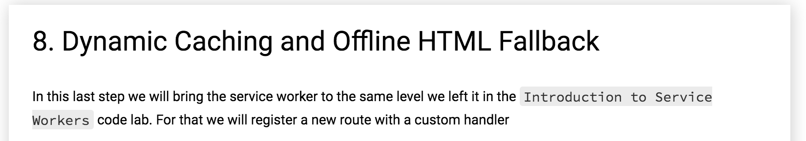

Slide 15
workbox.routing.registerRoute(
routeData => routeData.event.request.headers.get('accept').includes('text/html'),
args => {
return caches.match(args.event.request)
.then(response => {
if (response) {
console.log(response);
return response;
}
// Clone the request - a request is a stream and can be only consumed once
const requestToCache = args.event.request.clone();
// Try to make the original HTTP request as intended
return fetch(requestToCache)
.then(response => {
// If request fails or server responds with an error code, return that error immediately
if (!response || response.status !== 200) {
return response;
}
// Again clone the response because you need to add it into the cache and because it's used
// for the final return response
const responseToCache = response.clone();
caches.open('dynamic')
.then(cache => {
cache.put(requestToCache, responseToCache);
});
return response;
});
})
.catch(error => {
return caches.match('/fe-guild-2019-pwa/offline.html');
});
}
);

Slide 16
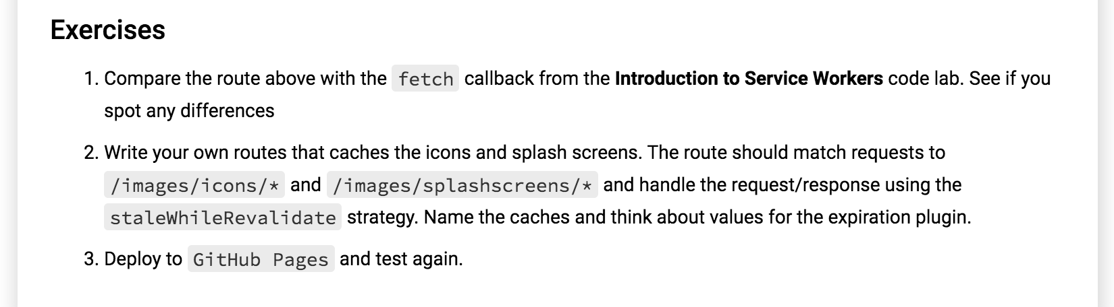

Slide 17
Solution

Slide 18
PUSH

Slide 19
Exercise and play
https://serviceworke.rs/push-simple_demo.html

